Slide 1
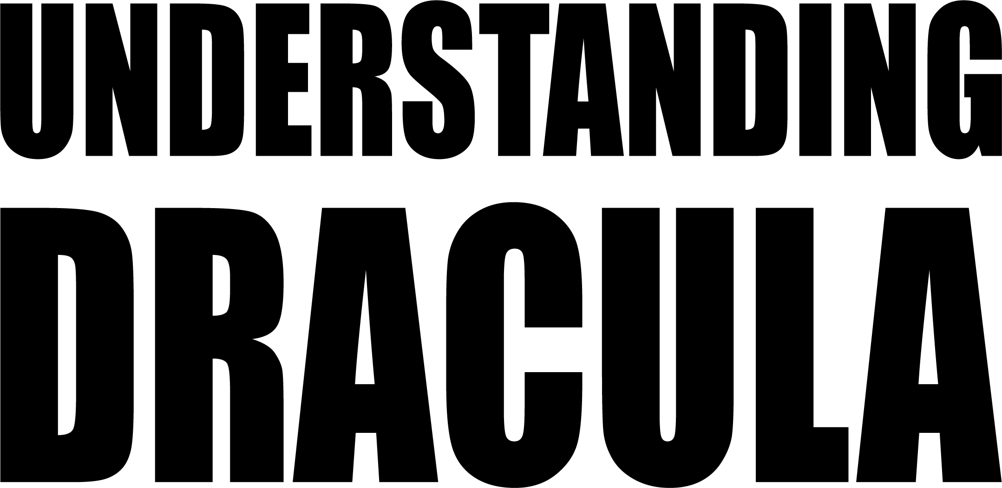
Lucien ledune – oscar liessens

Slide 2
Text pre-processing
Only keep chapters in the txt file. (Remove unnecessary parts before and after the book)
Divisions : Chapters/N sentences
Lowercase
Remove punctuation and special characters
Stemming of the words : reduce to its root form

Slide 3
Topic Extraction
First extract topics for all chapters
Then extract one topic from each chapter, trying to get the differences in topics and see the story progression

Slide 4

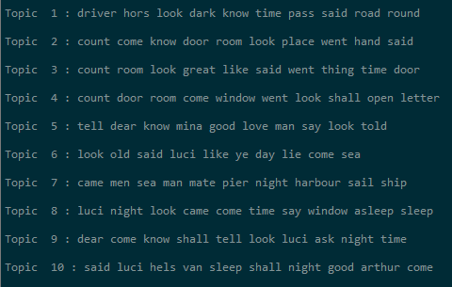
Topic extraction : LDA
Full text extraction :
Chapters Extraction (LDA) :
First chapter example : Jonathan travels to meet Count Dracula, travels in a coach with a driver

Slide 5
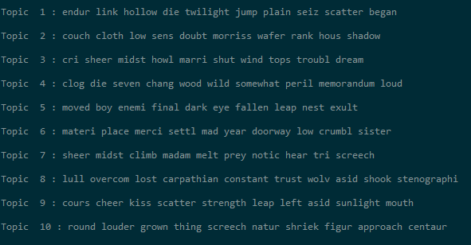
Topic extraction : NMF
Another algorithm often used for topix extraction is NMF, we use it to extract topics from chapters

Slide 6
Relationship graphs
We want to have a better understanding of the relationships between main characters in the book.
We generate an adjacency matrix from the book, checking how many times characters are mentionned together.
We use this to generate a graph of the book relationships
Then use pagerank to determine a ranking between characters.

Slide 7
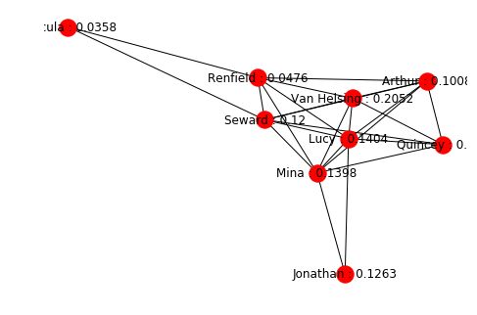
Relationships : Pagerank
Top left is Dracula, and value for Quincey is 0,084.
Dracula is not the main character (rarely appears)
Van helsing has the highest score.
Limitation : In the book Dracula is often referred as different names (« the beast … ») which makes it hard to capture every relation.
Advantages : Fast iterating algorithm that enables us to rank characters.

Slide 8
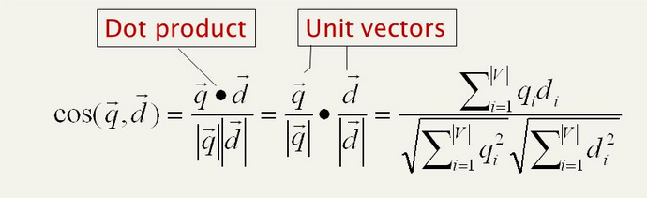
Simplified search engine
Using tf-idf we tried to make a simple search engine for the book.
This can prove very useful in case you havn’t read the book and want to search for specific parts.
Uses tfidf cosines to generate a similarity between query and documents, then return the highest one.

Slide 9
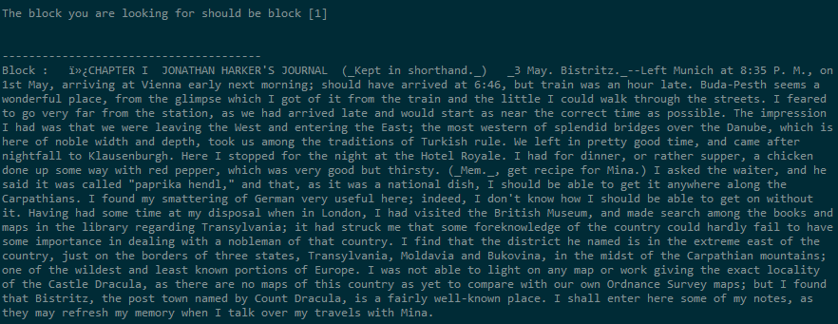
Tf-idf query exemple
"I stopped at hotel royale, we had a good diner and i then visited a museum.“
This is about the very beginning of the book so it should return first block

